Slide 1



The Center for Career Services
Chrissy James, M.Ed.
Career Exploration Coach
The Center for
Career Services
First Year Overview
Sonya B. Merrill, Ph.D.
STEM Industry Career Management Coach
Certified MBTI Practitioner
Center for Career Services
&
Lenore Webb, Associate Director/Coach
Center for Career Services

Slide 2
In this presentation…
Overview of The Center’s Services
Your Career Success: Plan; Tools; Connections
  Know Your Career Coach
  Know Yourself
  Know How to Make Connections
  Know How to Be a Professional
Your Resources
Getting Started
Your Feedback

Slide 3
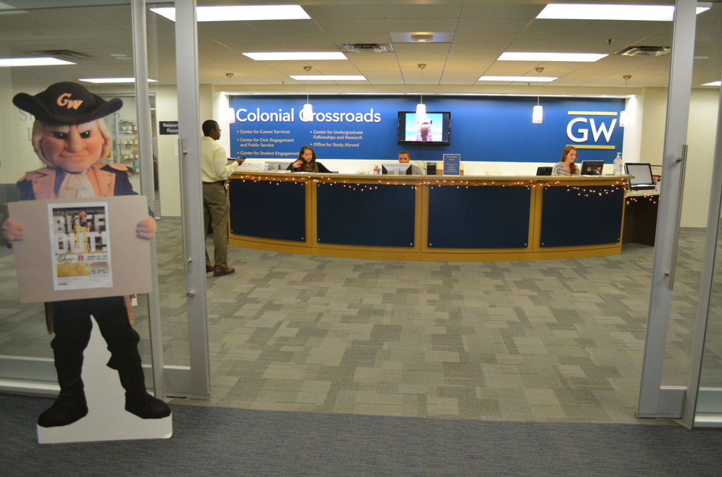
Where are we located?

Slide 4
What do we do?
Career Coaching, Goal Setting, Resumes, Networking, Mock Interviews, Job/Internship Search, Career Exploration, Salary Negotiation Strategies, etc.
Career Workshops, Panels, Info Sessions, Employer events, On Campus Recruiting
Self-Assessment ,Workshops & Individual sessions
Career Fairs, Site Visits, Employer-in-Residence
Student Employment, Federal Work Study, on & off campus jobs
Special Programming for International Students, Veterans, Athletes, Students with Disabilities Support, and more
Funding for unpaid internships
Career Treks, Employer Site Visits, Career Courses
Notes:
Also KACIF, funding for internships and student career projects

Slide 5
The Career Success Formula
Ingredients
The PLAN
The TOOLS
The CONNECTIONS
Notes:
Also KACIF, funding for internships and student career projects

Slide 6
. . . . Behind every success story there’s a PLAN . . . .
Know Your Career Coach
Know Yourself
Know How to Connect with Employers
Know How to Be a Professional
Notes:
Behind every success story, there’s a plan
At GW, we believe that each student is unique and thus everyone’s journey to their future career is different. Our goal is to help students develop an individualized plan which puts their knowledge into action and builds skills for internships and jobs.
Know your Career Coach
Our Career Coaches help students develop a personalized plan for career success. We develop that plan by understanding the student’s capabilities and needs, developing clear action items, and connecting them to the right programs and resources. A coach will help you . . .
Know Yourself
Connect your passions to a purpose
Gain self-knowledge and connect your passions with a practical strategy for advancing your career.
Understand how your talents relate to academic and career options so you can put your skills to work and knowledge in action at GW, in DC and beyond.
Envision the future professional “you” and clearly communicate your aspirations to people who matter.
Know How to Connect with Employers
Bring your dream job closer to reality
Devise and implement a clear strategy for finding jobs and internships through research, reflection and goal setting.
Learn how to take full advantage of GW connections and build a powerful network of students, alumni, university partners and potential employers.
Navigate the hiring process, from resumes and cover letters to interviews and salary negotiations, to stand out and demonstrate your GW talent.
Know How to be A Professional
Make a successful “classroom to career” transition
Translate your academic, co-curricular and internship experiences and refine your marketable skills.
Develop an online persona that demonstrates strengths and industry-specific skills applied in roles of increasing responsibility and professionalism.
Establish relationships with classmates, colleagues, supervisors and professors who can serve as mentors and references.

Slide 7
Know Your Career Coach
Career Exploration Coaches
Personal Assessments
Industry Coaches
Identify Industry-specific Employers, Skills, Strategies
Exploring Careers and Majors
Hiring Process
Notes:
Discuss the distinction between CECs and Industry Coaches, what they focus on and help students with

Slide 8

Know Yourself
Personality
Interests
Values
Strengths
Clifton Strengths
careerservices.gwu.edu
Notes:
At the start of your career development process, you need to know what you’re looking for and why you’re looking for it. Starts with understanding yourself.
Do you know what your interested in? It could be the field or industry, who or what you want to work with
Realistic
Investigative
Artistic
Social
Enterprising
Conventional
What kinds of skills do you have? Do you work best with computers or people? Do you have strong communication or presentation skills? Are you creative or artistic?
What are your work values? What is important to you in a work setting and for work fulfillment?
Using this knowledge of yourself will help guide you in narrowing down your field of choices.
If you are hearing these questions and you don’t know the answers or you’re starting to feel overwhelmed, make an appointment with a career consultant at the foundation level to discover these answers.
We love hearing students’ stories (we start them on their way)
Help students find their fit
Articulate interests, values, and skills
Begin to formulate a work environment
Putting experiences on resume and helping them see the value in all of their experiences
Begin to put words and focus to all of the above for their story

Slide 9
The TOOL(S) Box
Resume
Handshake Profile/LinkedIn
Value Speech
E-Portfolio
Business cards
Personal/Purpose Statement
Library Resources – Academic Commons

Slide 10
Know How to make CONNECTIONS
ALUMNI
EMPLOYERS
FACULTY
STUDENT ORGANIZATIONS
=
ENGAGEMENT

Slide 11
Becoming a Professional
Professional Competencies
Global Perspective
Critical Thinking /Problem Solving
Tech/Info Management
Teamwork
Communication
Career Management
Leadership
Professionalism
Notes:
-Where can you get leadership experience?
-400+ student org’s
-Part time jobs = transferrable skills
-Find research or writing experience
-Volunteering or service oriented work- break out of the box that says experiences is only paid full time positions. GW is service-oriented. Take advantage

Slide 12

Becoming a Professional
Ways to get
experience now:
  Student Organizations
  Part-time jobs
  Research
  Volunteering
  Internships
Dos and Don’ts
Manage or avoid credit card debt
Refrain from downloading copyrighted material (books, videos, music)
Clean-up social media
Refrain from the use of illegal Rx, substances, excessive alcohol
Notes:
-Where can you get leadership experience?
-400+ student org’s
-Part time jobs = transferrable skills
-Find research or writing experience
-Volunteering or service oriented work- break out of the box that says experiences is only paid full time positions. GW is service-oriented. Take advantage

Slide 13
NEXT STEPS
Know Your
Strengths
Notes:
Highlight key features that students might be interested in. We will stay after if they want to see how it works – show you features on laptop/iPAD
GWork = online database of jobs and internships with employers we have a connection or relationship with

Slide 14

GETTING STARTED
It all happens in HANDSHAKE
Make Appointments with a Career Coach
Job and Internship Postings
Resources (Career Path Summaries, Employer Lists, How-To Guides, Sample Resumes)
Register for Career Events (Fairs, On-Campus Recruiting, Workshops, Employer-In-Residence)on Handshake
Notes:
Highlight key features that students might be interested in. We will stay after if they want to see how it works – show you features on laptop/iPAD
GWork = online database of jobs and internships with employers we have a connection or relationship with

Slide 15


GETTING STARTED
It all happens in HANDSHAKE…
Events for YOU!
STEM Ice Cream Social | Career Fair
Notes:
Highlight key features that students might be interested in. We will stay after if they want to see how it works – show you features on laptop/iPAD
GWork = online database of jobs and internships with employers we have a connection or relationship with

Slide 16
Get Ready to Meet the CIA
Save the Date:
October 4 CIA Pizza & Internships Pop-Up
Plan NOW to Be Competitive in the Intelligence Industry
Exclusive opportunities for first year student applicants
Paid internships for sophomore year for all SEAS majors
Ongoing professional development and mentorship
Interested in learning more, go here (https://gwu.joinhandshake.com/articles/12671):
How Do I Get a Job In Intelligence?
Notes:
Highlight key features that students might be interested in. We will stay after if they want to see how it works – show you features on laptop/iPAD
GWork = online database of jobs and internships with employers we have a connection or relationship with

Slide 17
Your Feedback…
Is Essential. Go to…
go.gwu.edu/ccsprogrameval
…the link to the program evaluation.
Should take approximately 2 minutes.

Slide 18




Questions?
Colonial Crossroads – Marvin Center 505
Careerservices.gwu.edu
gwcareercenter@gwu.edu
202.994.8787
CCS SEH Satellite Hours: Mondays from 1-3:30pm
  (1-2pm - Drop ins; 2-3:30, 30 minute appointments,
  Rm. 1630)
Connect & engage with the GW Center for Career Services:

